Slide 1
How to Really Practice Radiology
Ashley Davidoff
Boston Medical Center

Slide 2
If you ask any highly accomplished
Musician
Athlete
Tennis, Football, Running, Shot putting etc etc
Singer
Dancer
Ceramicist
Photographer
Their Secret to Success,
the Universal Answer is …

Slide 3
Practice, Practice, Practice,
and then
More Practice!

Slide 4
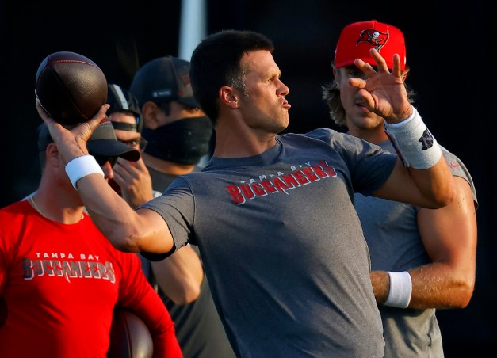
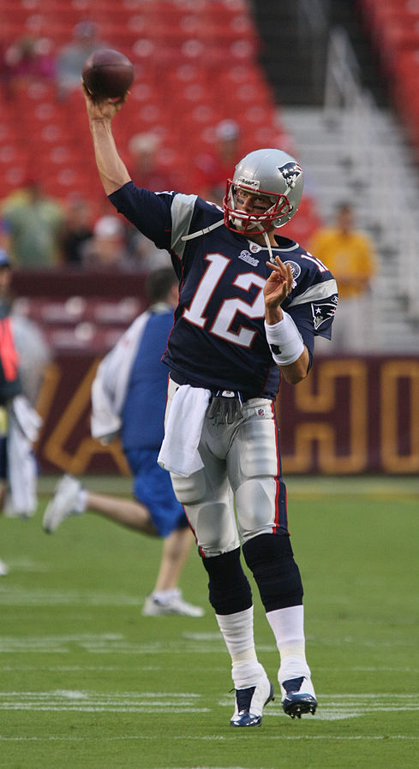
Tom Brady
Notes:
Did he excel because he just played the game the whole day? Break the skill up into its parts and practice each part separately

Slide 5
So When We Say We Practice Radiology Do we Really Practice? Probably Not in the True Sense of the Word So …. How Can We Really Practice Radiology?

Slide 6
We have 3 Tools to Work With

Slide 7
And the skills we have to have, and develop, are many …. but start with curiosity We apply these at the reading work station But why not practice these for the rest of the time – from dawn to dusk
Notes:
Zakim Bridge Bunker Hill Monument Charles River The Pru

Slide 8
3 of the Many Games I Play to Practice the Skills of Looking and Seeing
Notes Scales and Music
Sherlock Holmes Approach
dOG wALK aRT

Slide 9
and now a Tap Dance to demonstrate Notes Scales and Music

Slide 11
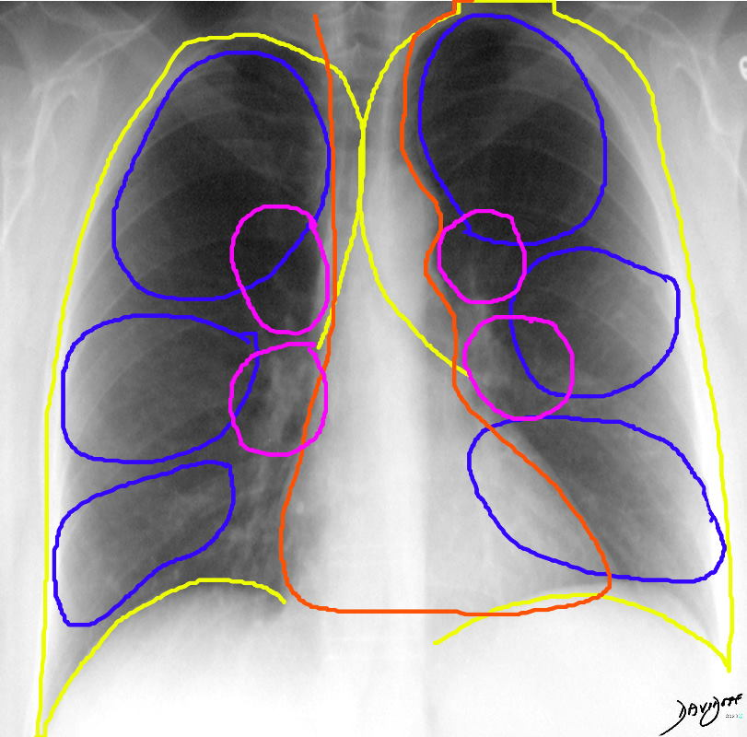
To the Resident “Draw Your Search Pattern in the Air - No Words”

Slide 12
Game 2 Sherlock Holmes Approach
“We approached the case, you remember with an absolutely blank mind, which is always an advantage. We had formed no theories. We were simply there to observe and to draw inferences from our observations.”
(The Adventure of the Cardboard Box)
With many other relevant quotes to our profession
The Common Vein
Sherlock Holmes

Slide 13
Tell the Story without Looking at the History

Slide 14
Game 3 Dog Walk Art
Look Observe and See While We Walk or Live the Rest of Our Lives

Slide 15
Conclusions
1 Foster and Inspire Curiosity –
2) Practice, Practice, and more Practice
in the Real Sense of the Word at the
Work Station and in the
Free Museums Around Us

